Slide 1
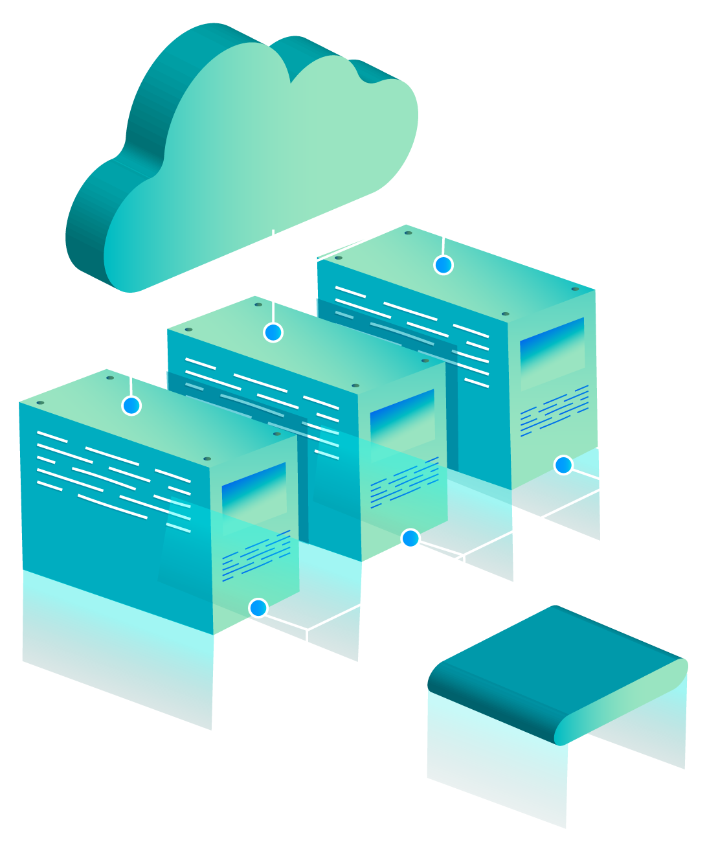
INTRO TO
AWS
MDIBL Comparative Genomics and Data Science Core

Slide 2
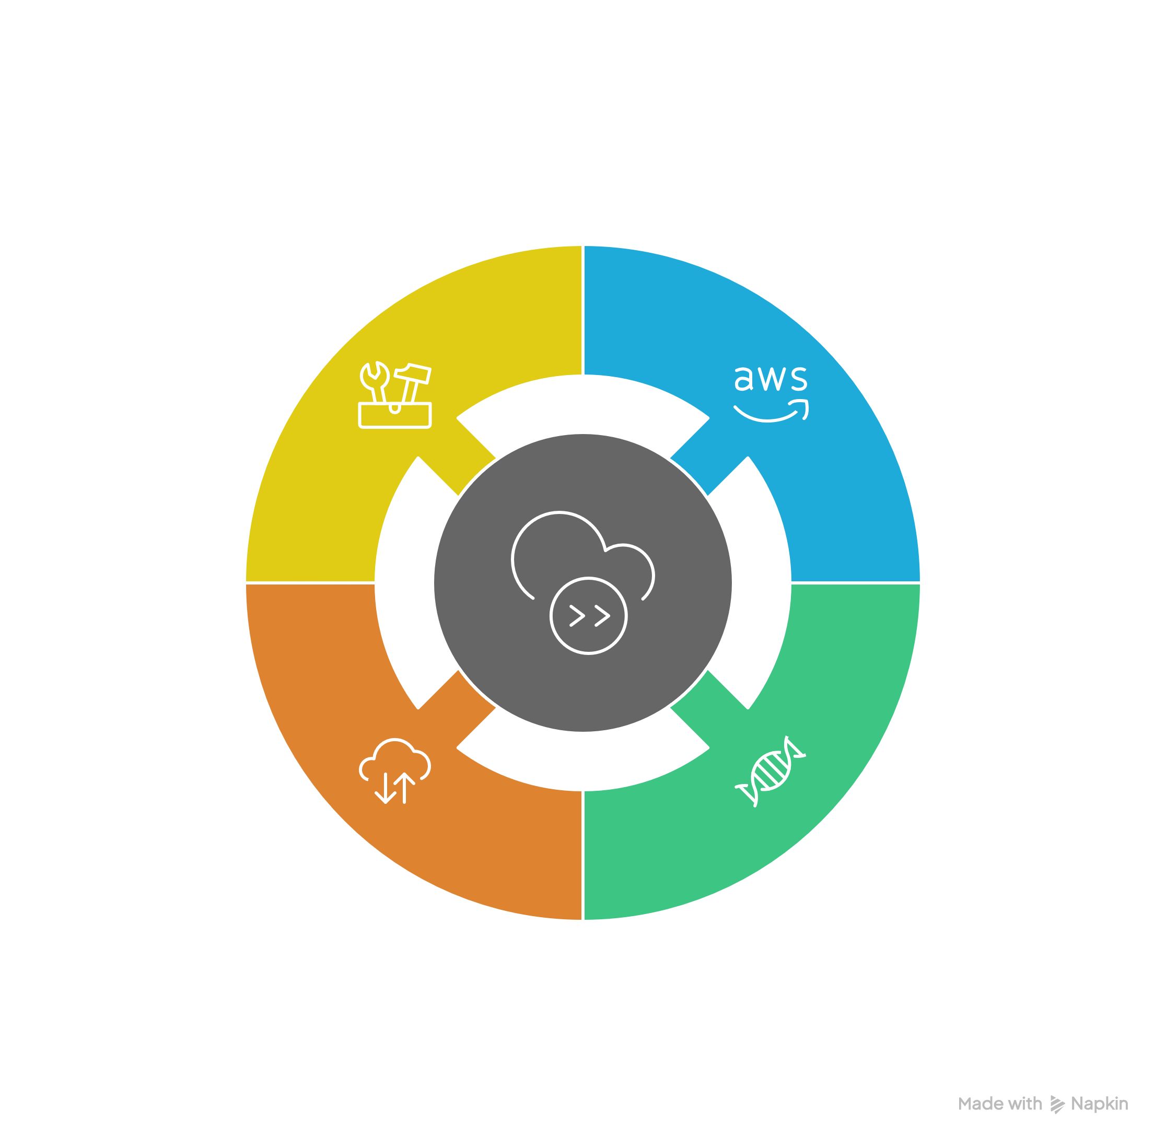
TABLE OF CONTENTS

Slide 3
01
What is AWS

Slide 4

Question
What is the cloud computing?

Slide 5

—AWS
Cloud computing is the on-demand delivery of IT resources over the Internet with pay-as-you-go pricing. Instead of buying, owning, and maintaining physical data centers and servers, you can access technology services, such as computing power, storage, and databases, on an as-needed basis from a cloud provider like Amazon Web Services.
Notes:
https://aws.amazon.com/what-is-cloud-computing/

Slide 6
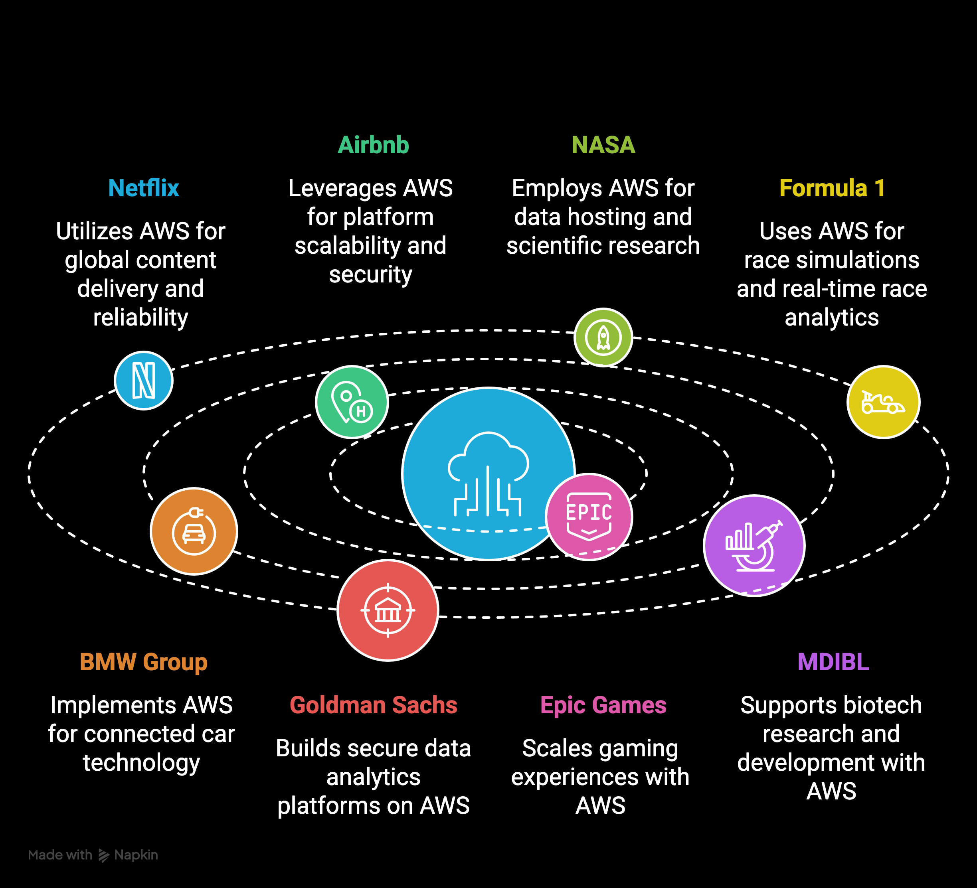
Applications

Slide 7
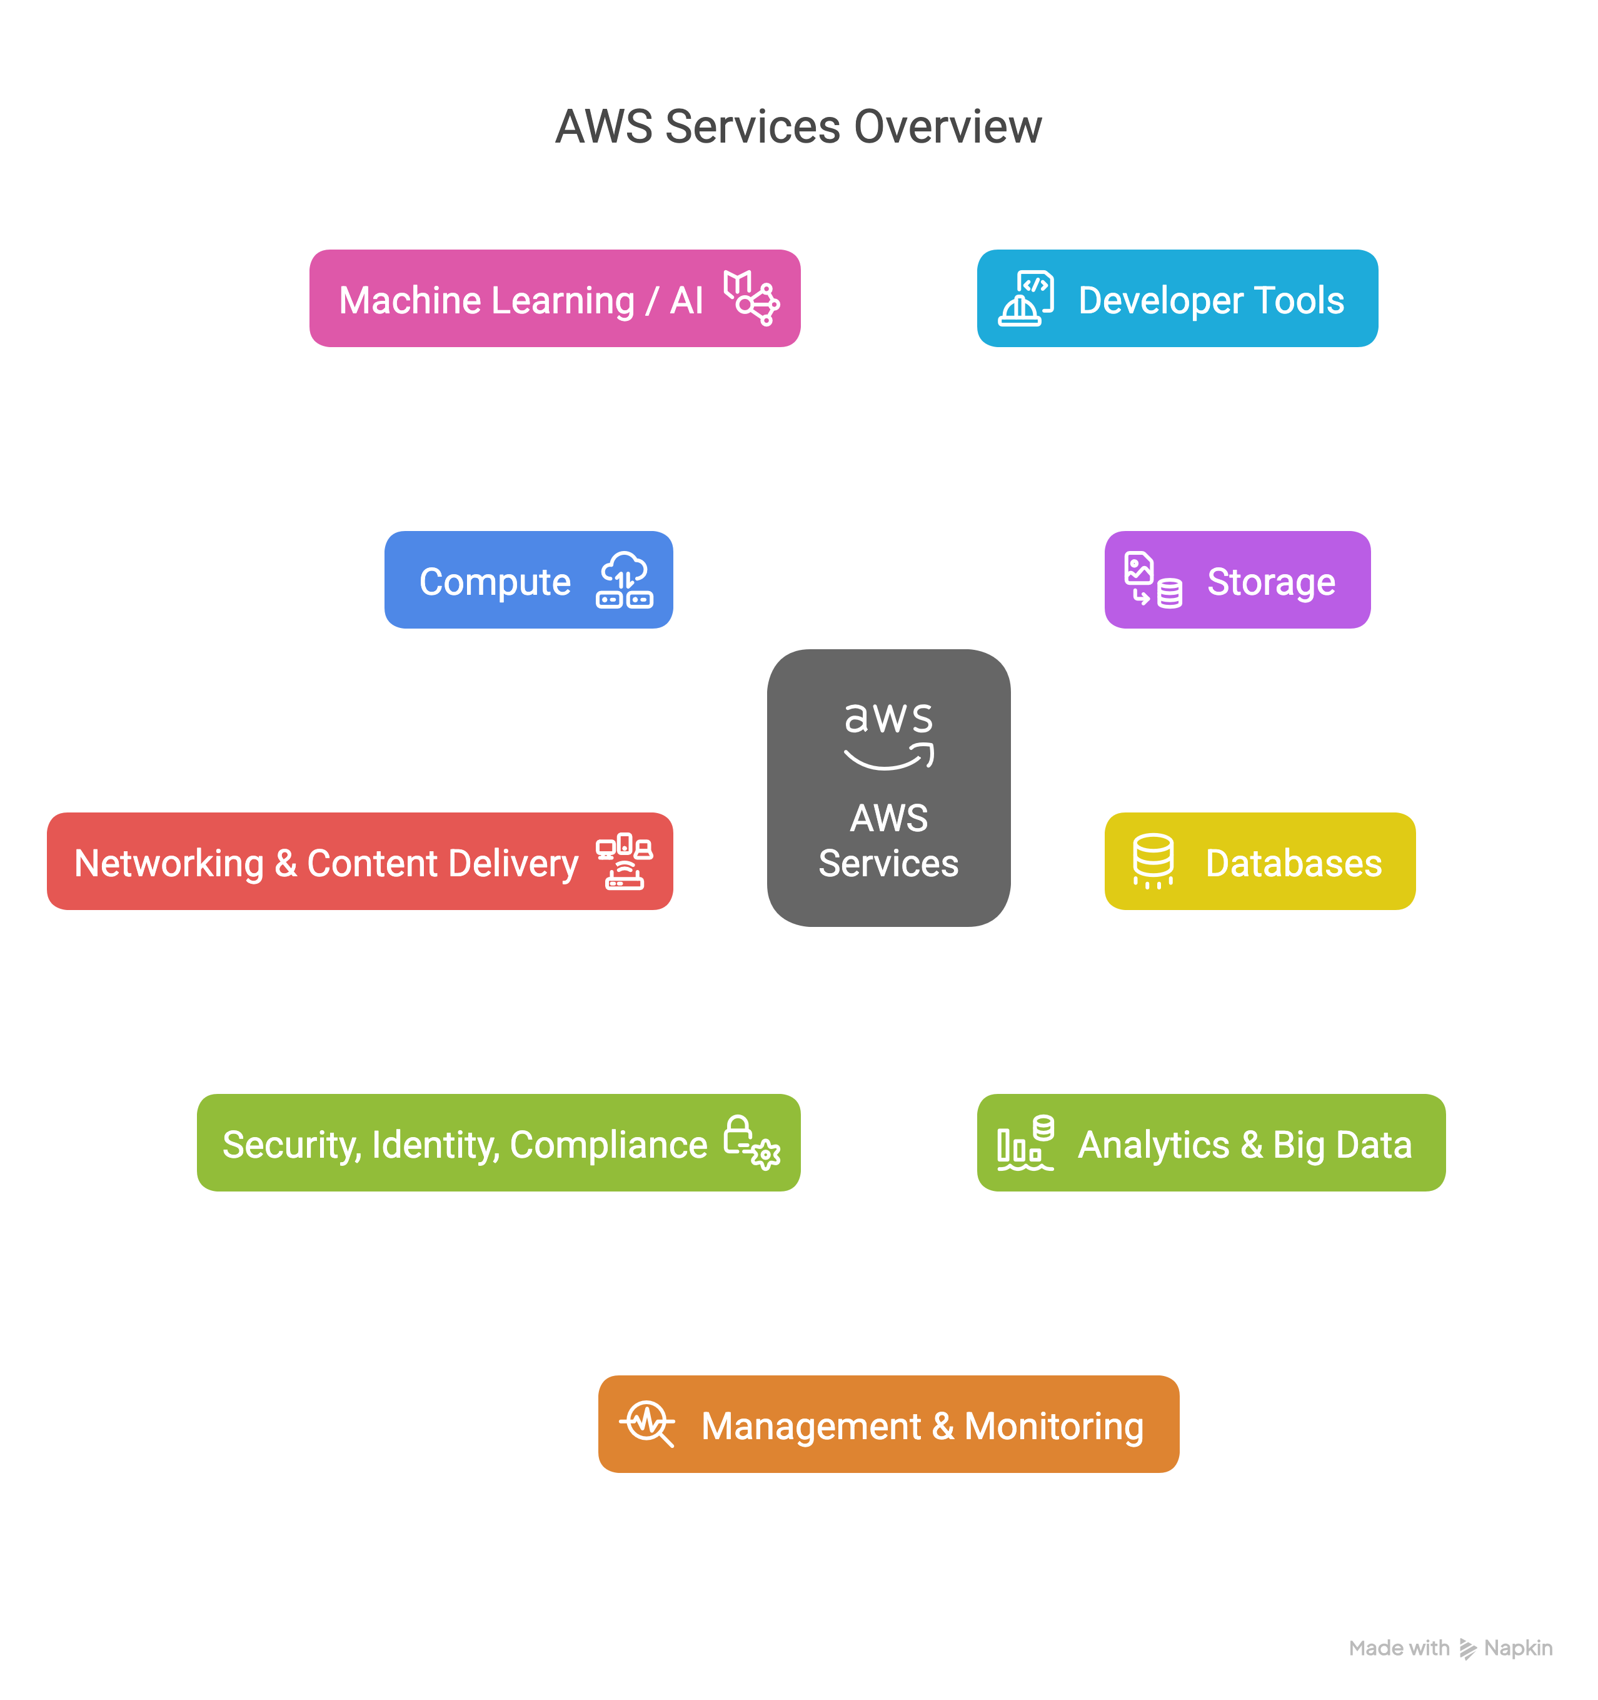
AWS
Distinct Services
+240
Extensive…
Only use a subset
Support from AWS
Massively scalable -- use as you like

Slide 8
02
Bioinformatics Stack

Slide 9
Services

Slide 10

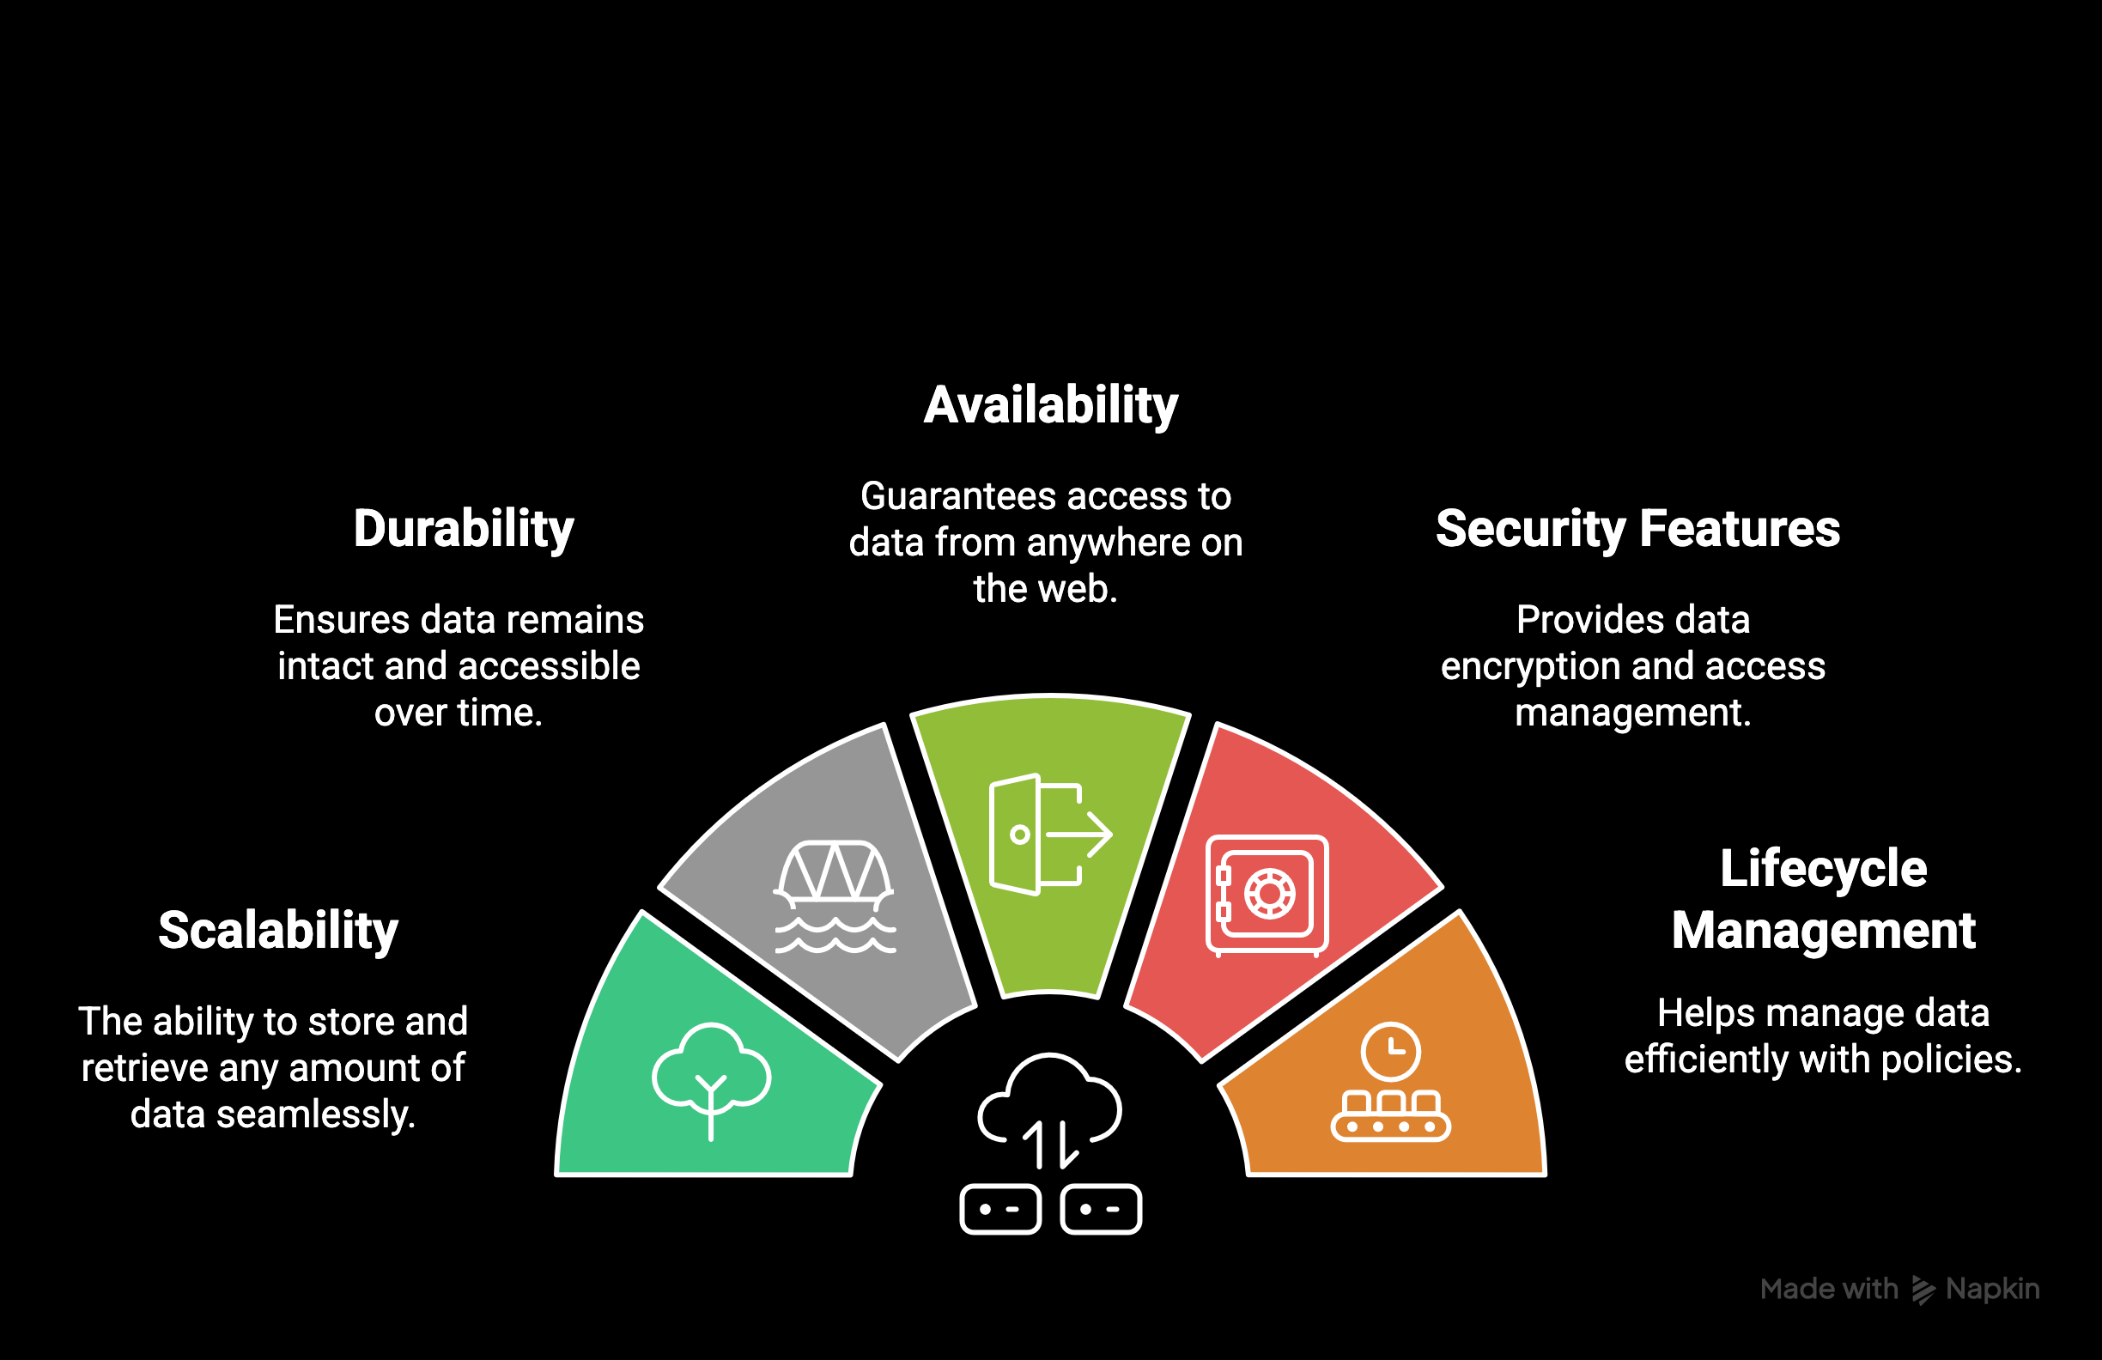

Storage – S3
Simple Storage Service

Slide 11
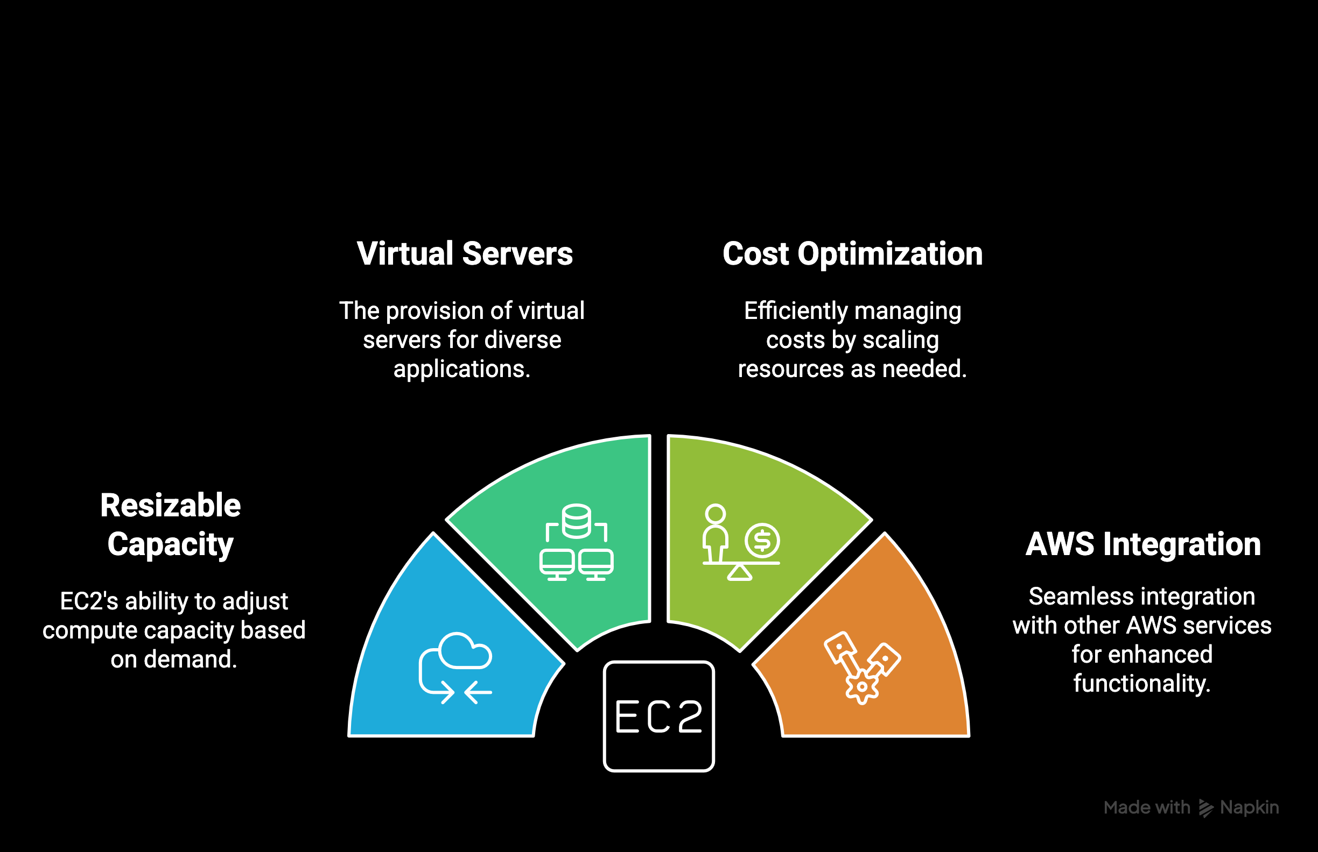

Compute – EC2
Elastic Compute Cloud

Slide 12
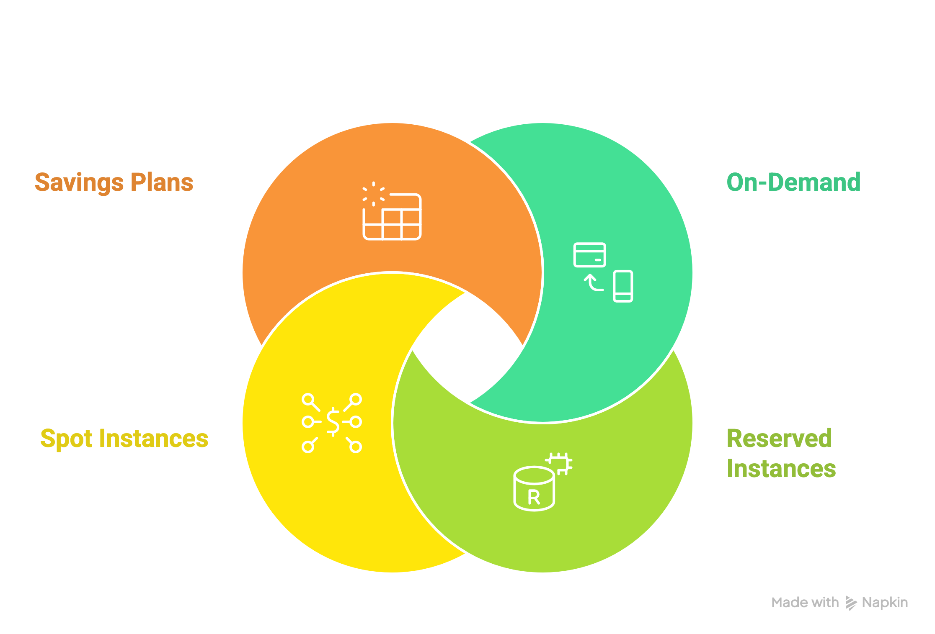
Compute – EC2
Elastic Compute Cloud

Slide 13


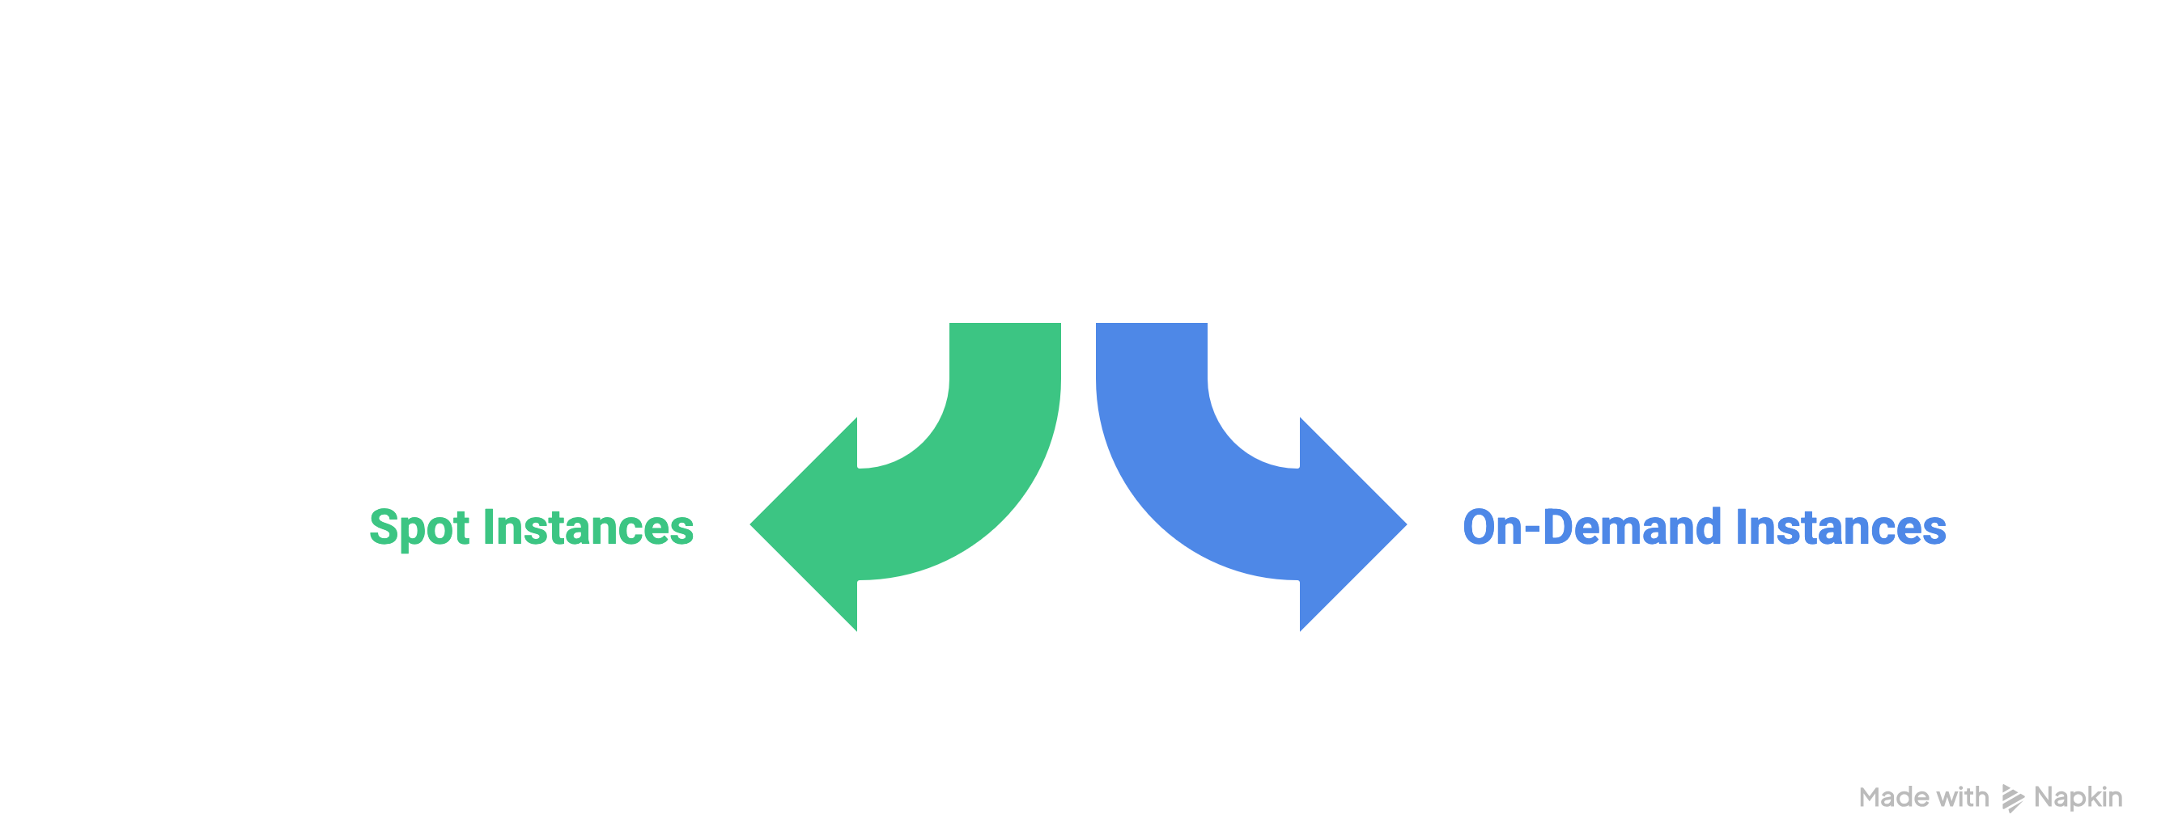
Compute – EC2
Elastic Compute Cloud
$0.30893
r5.4xlarge
$1.008
$0.8930
x1e.4xlarge
$3.336

Slide 14
03
Memverge

Slide 15
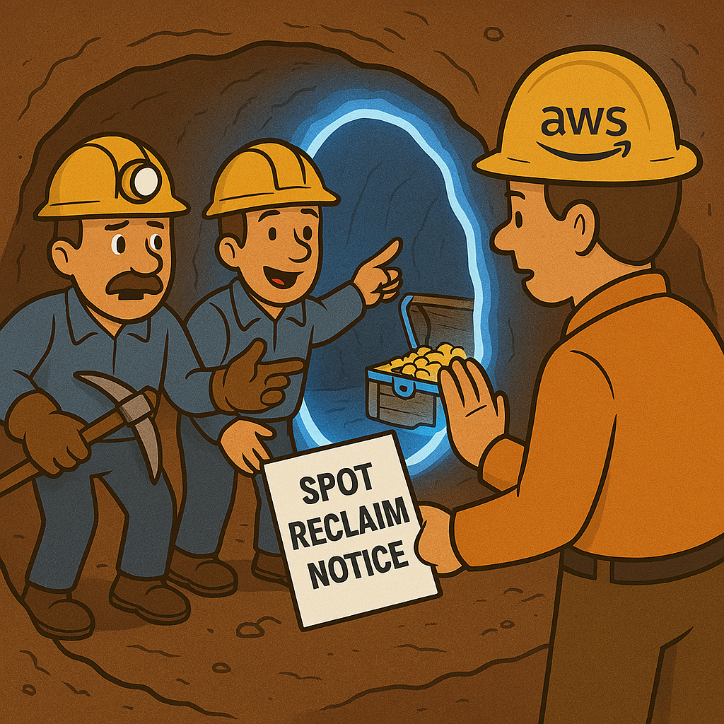
MEMVERGE SpotSurfer

Slide 16


Memverge - SpotSurfer
Memory Machine Cloud

Slide 17
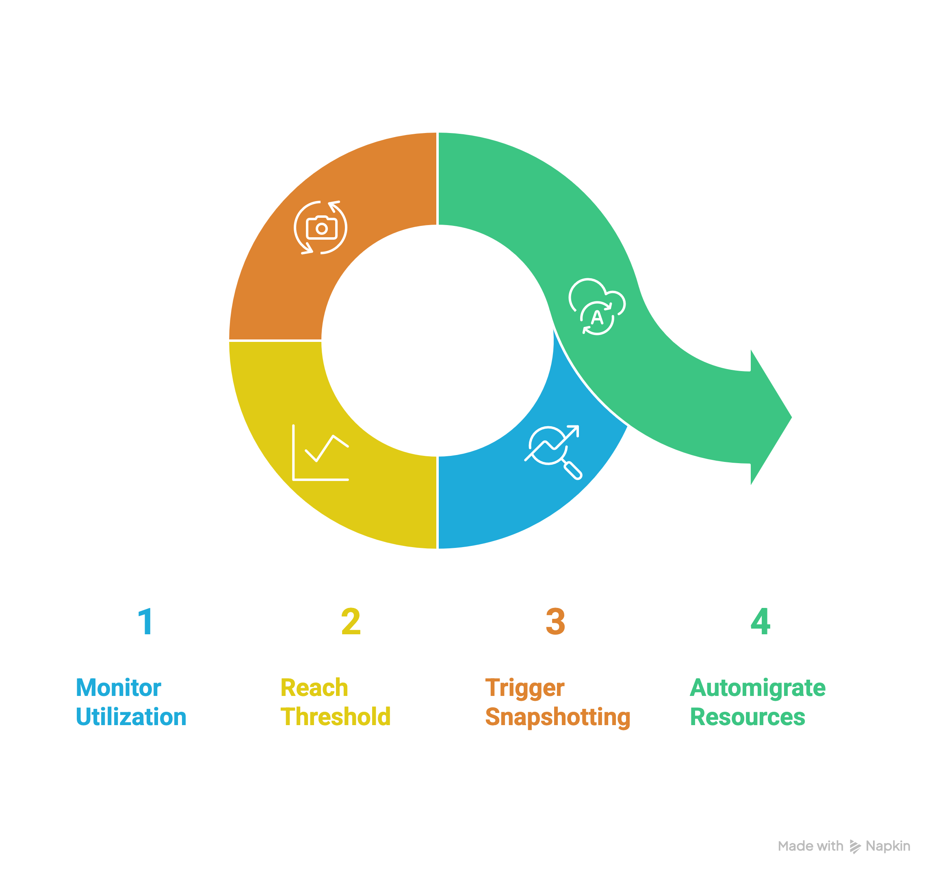
Memverge - WaveRider
Memory Machine Cloud

Slide 18




Architecture
AWS EC2 Virtual Machines
MMC OpCenter
Orchestrates Jobs
AWS S3 Storage
Data & Reference
Head Node
(read only)
Executes Workflow
Work
Directory
Publish Directory
Worker Nodes

Slide 19
04
Other Use Cases

Slide 20

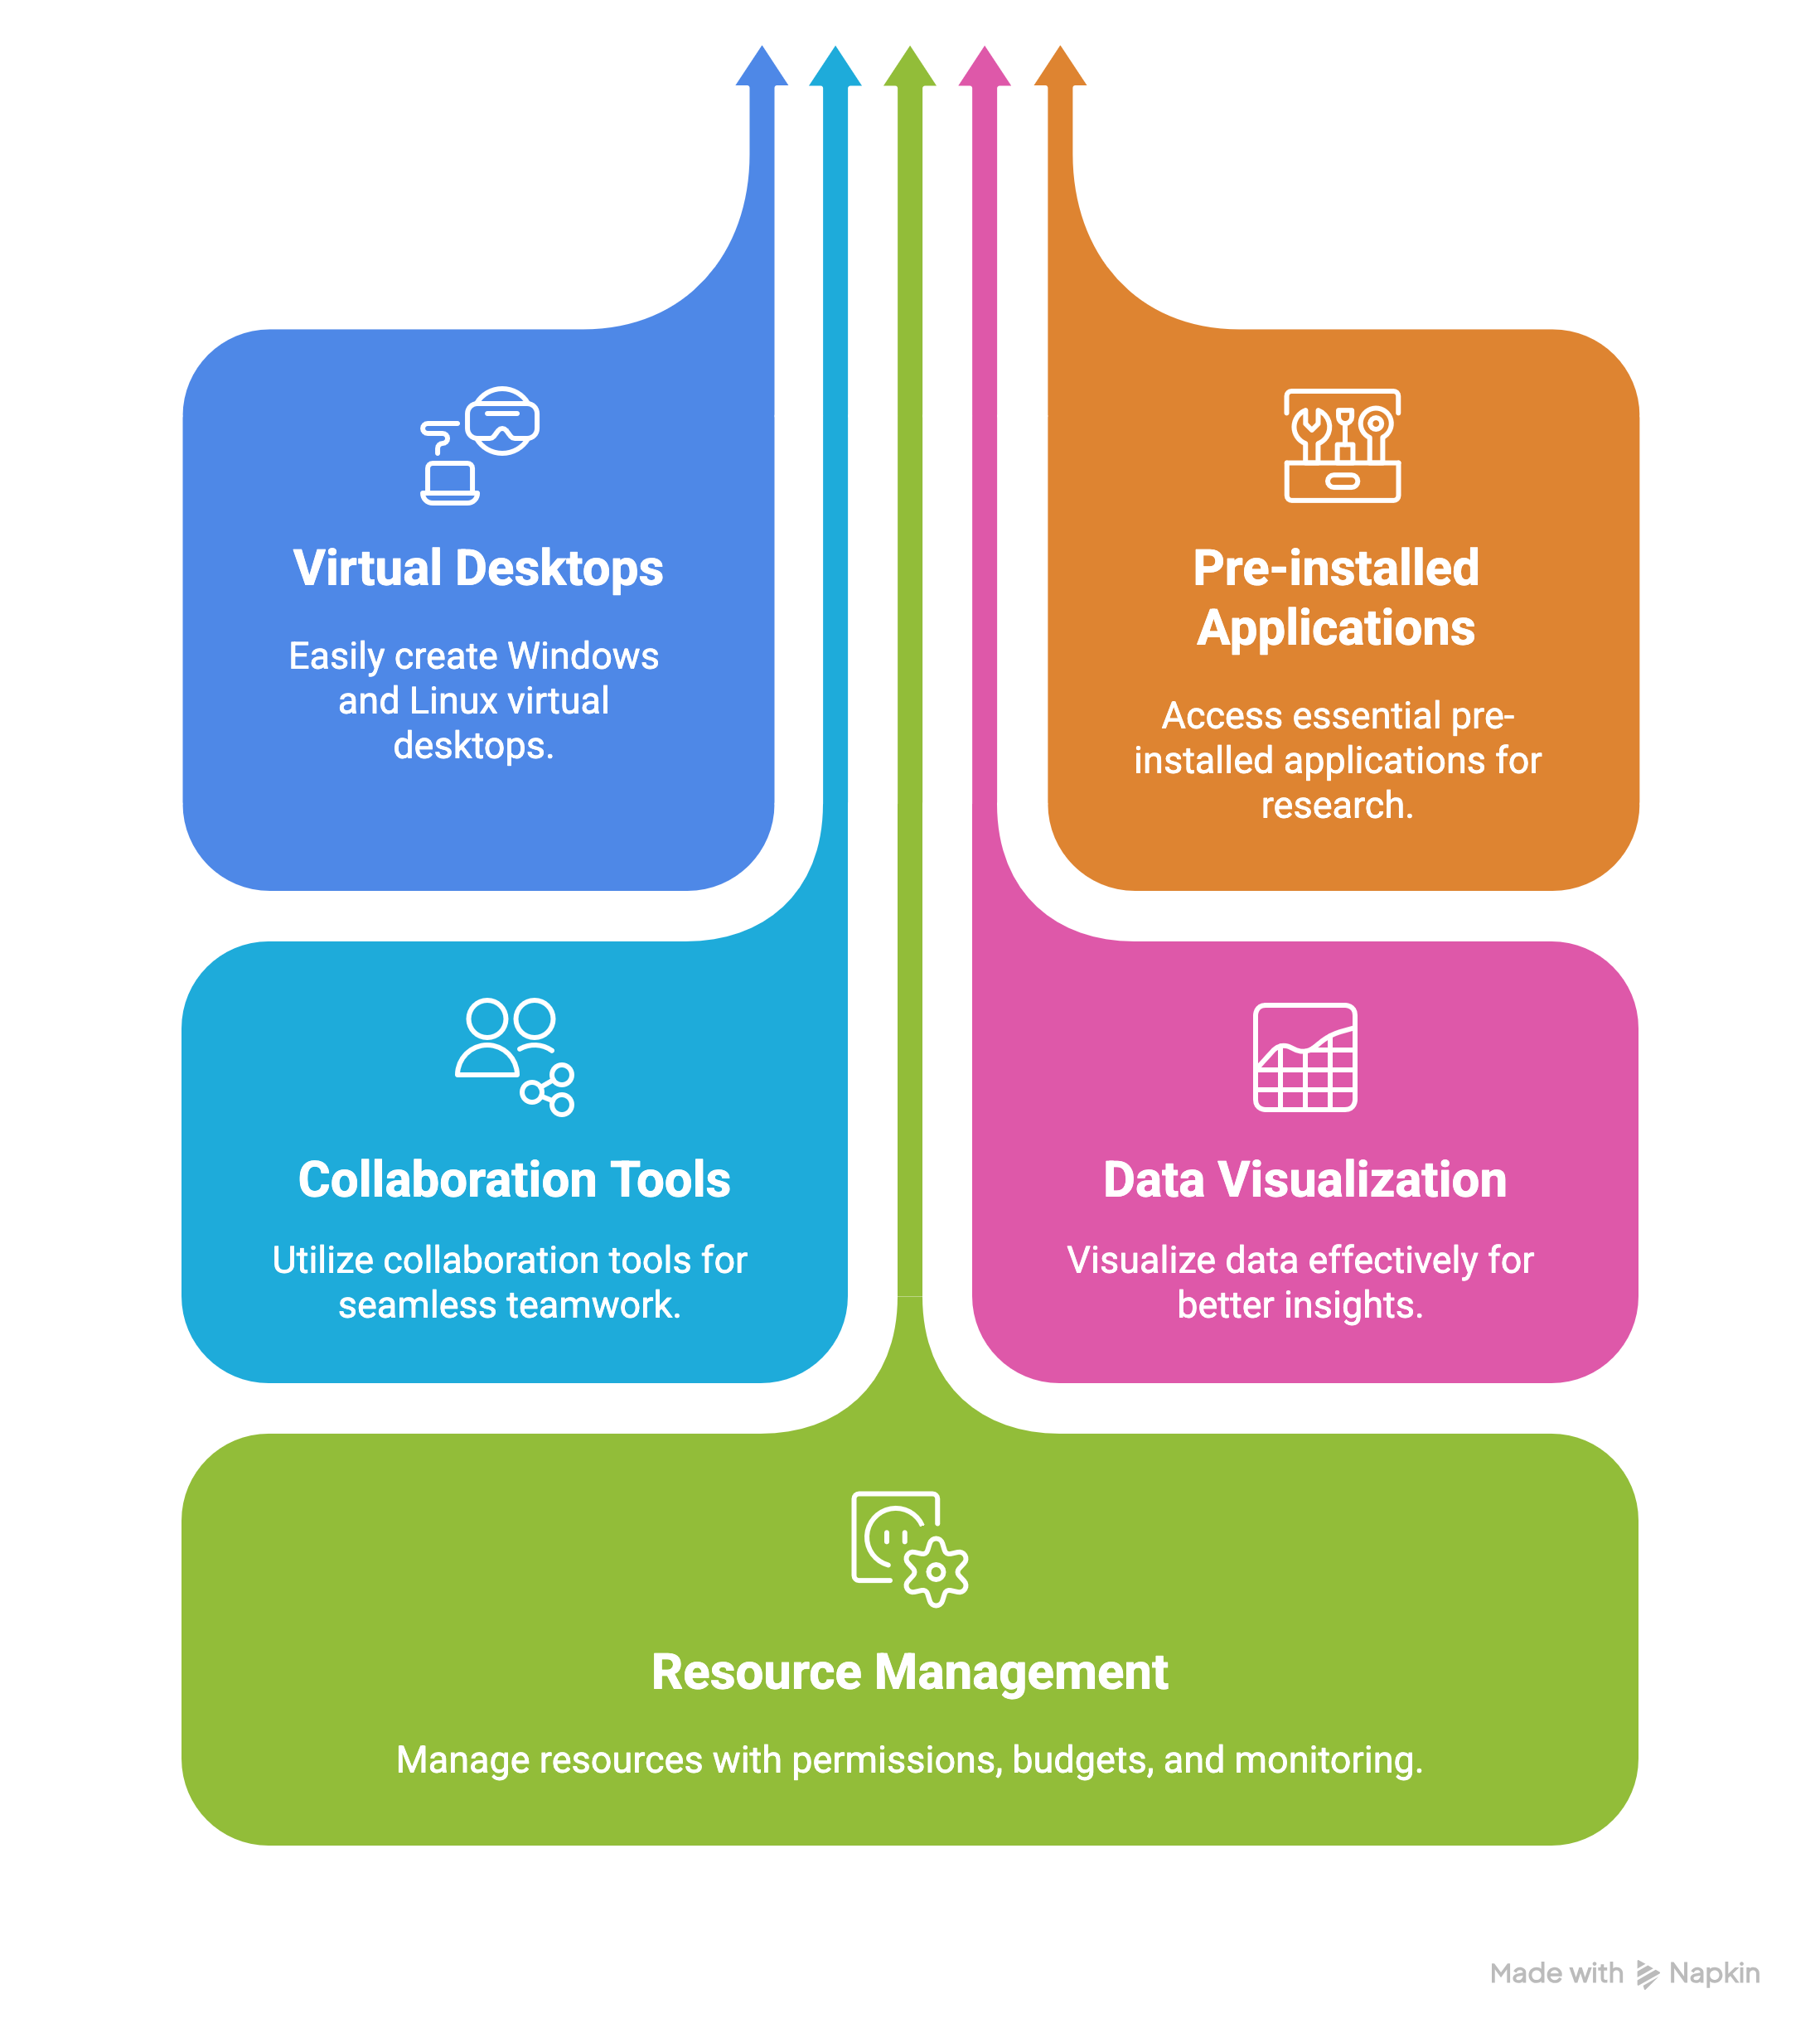
AWS - RES
Research Engineering Studio

Slide 21

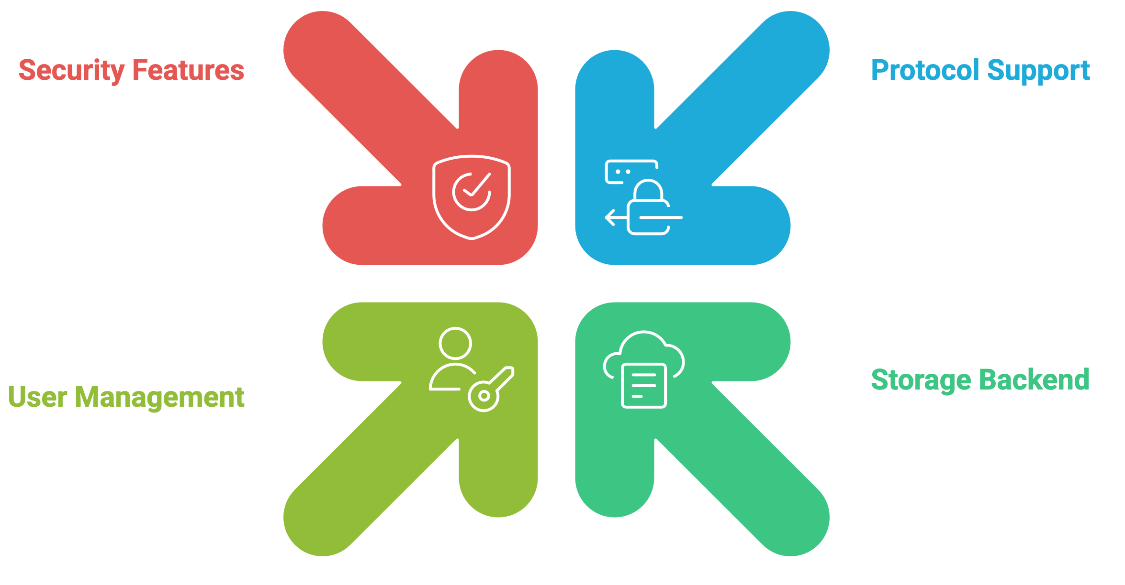
AWS - Transfer
Transfer Family

Slide 22

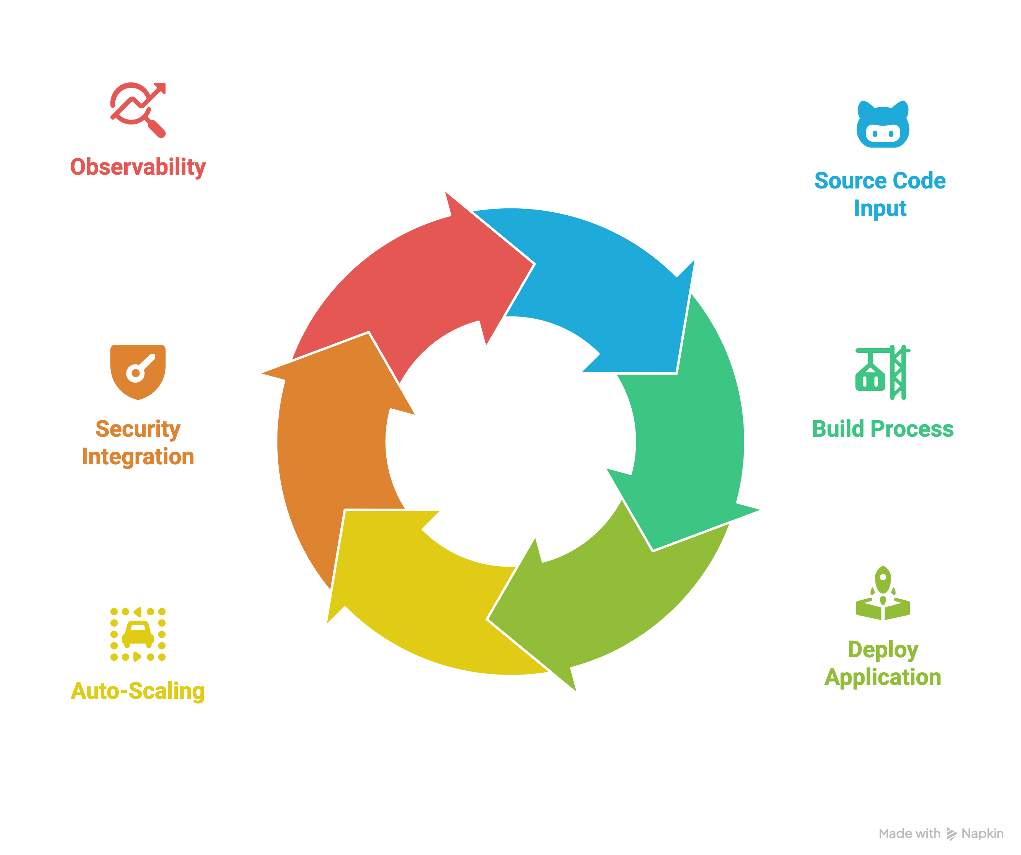
AWS - Apps
App Runner
Notes:
Lightsail, fargate

Slide 23
Questions

